Slide 1
Cognitive Search Lab – Knowledge Mining on Business Documents
Rodrigo Souza – rosouz@microsoft.com
Applied Data Scientist
LearnAI Team / Cloud & AI

Slide 2
LearnAI Team http://aka.ms/LearnAI-Portal http://aka.ms/LearnAI-GitHub http://aka.ms/LearnAI-Links This Training http://aka.ms/LearnAI-Airlift

Slide 3
Training Goals – What Will You Learn
Cognitive Services
Computer Vision
Custom Vision
LUIS
Content Moderator
Text and Knowledge APIs
Bing Search API
Azure Search / Cognitive Search
Bots
Azure Functions
Poll

Slide 4
Training Goals – How Will You Learn
Presentations
Hands-On Labs to Build E2E Applications
Intelligent Search
Cognitive Search
Bot Interfaces for both
1.5 days for each

Slide 5
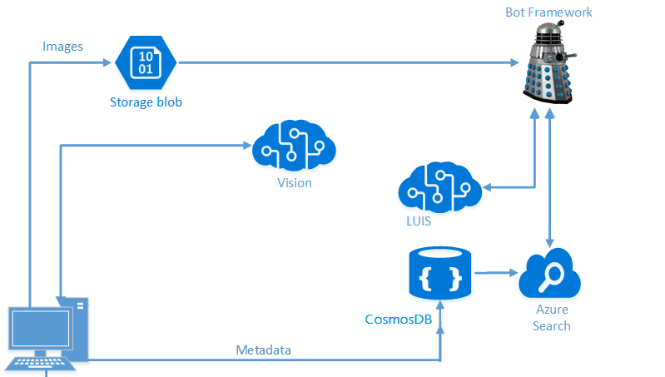
Architecture – Intelligent Search

Slide 6
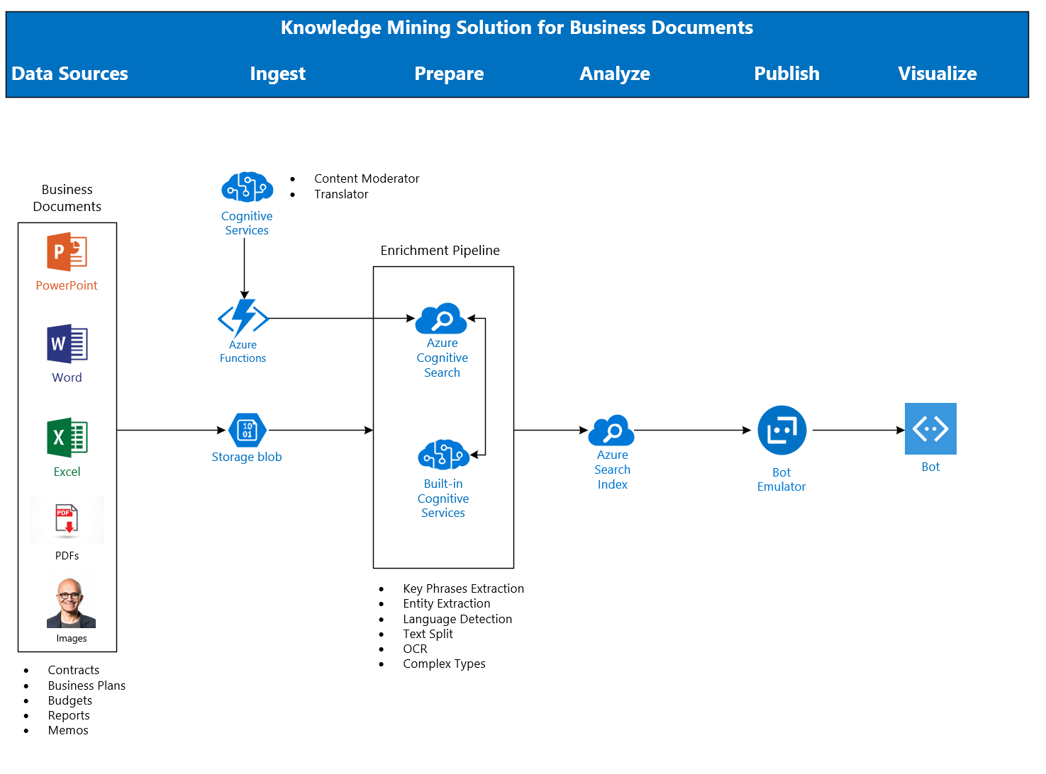
Architecture - Cognitive Search

Slide 7
Housekeeping
Breaks
Lunch
Restrooms
Wi-Fi
Audience
Partners
Microsoft
Office Hours
Survey

Slide 8
Spektra Environment
Azure Account
DSVM
Deployed Services: storage account, CosmosDB, Computer Vision API
Azure Search should be created in the same region of the DSVM

Slide 9
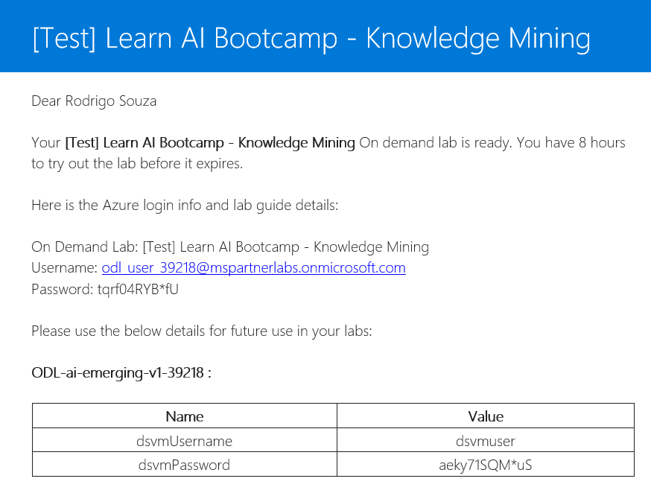
Spektra Environment
http://bit.ly/2TLIik3
Confirmation email from noreply@cloudlabs.ai

Slide 10
Breaking News
Container support in Azure Cognitive Services
https://docs.microsoft.com/en-us/azure/cognitive-services/cognitive-services-container-support
Power BI delivers AI power
https://www.zdnet.com/article/power-bi-delivers-ai-power/

Slide 11
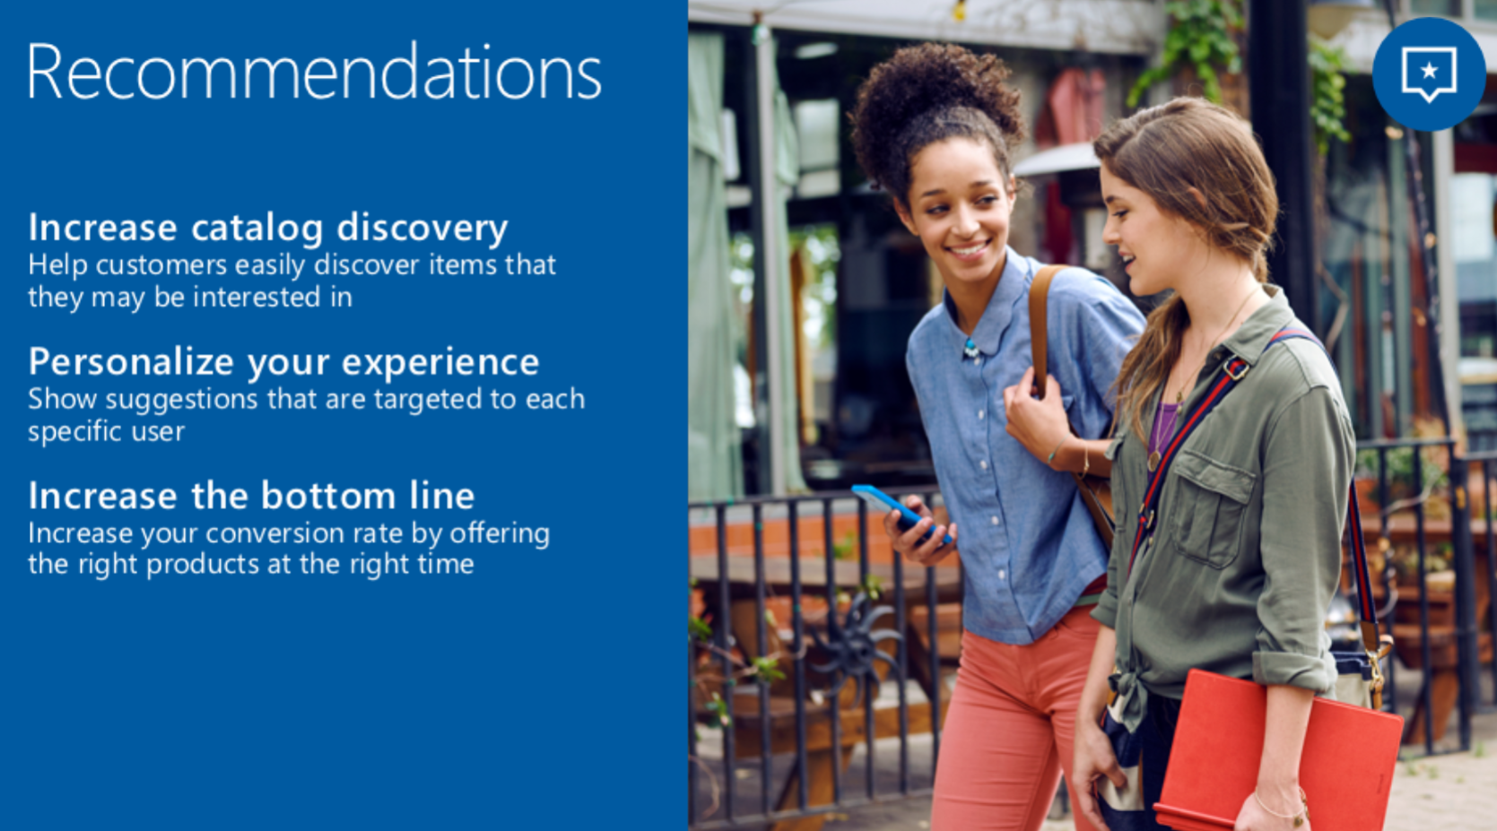
Breaking News

Slide 12
Let’s go! http://aka.ms/LearnAI-Airlift

Slide 13
Backup Slides

Slide 14
Announcements

Slide 15
Opening Demos
www.azure.com/cognitive
Curl

Slide 16
Custom Vision URLs
https://docs.microsoft.com/en-gb/azure/cognitive-services/custom-vision-service/getting-started-build-a-classifier
http://customvision.ai

